Slide 1
VO2 Max
Endurance Training for a Healthy Lifestyle

Slide 2
Please read the following articles so we can discuss as a class…
http://www.ucdmc.ucdavis.edu/sportsmedicine/resources/vo2description.html
http://www.runnersworld.com/sweat-science/who-has-the-greatest-vo2max-of-them-all
http://www.active.com/running/articles/how-to-maximize-your-vo2max-training

Slide 3
VO2 Max
What is VO2 Max?
  “VO2 max refers to the amount of oxygen that an individual can utilize during intense or maximal exercise. It is measured as “milliliters of oxygen used in one minute per kilogram of bodyweight”…”This measurement is generally considered the best indicator of an athlete’s cardiovascular fitness and aerobic endurance”…”The more oxygen you can use during high level exercise, the more ATP (energy) you can produce.
  “VO2 max is an index of the body’s efficiency at producing work.”…”There are many factors that can influence VO2 max e.g. heredity, training, age, gender, body composition”…”VO2 max is the ‘gold standard’ measure of overall fitness”
---UC, Davis

Slide 4
VO2 Max
Why is this important?
  “Significant amounts of research and public health data indicate that low fitness are correlated with an increased risk of premature death from many causes but in particular from cardiovascular disease. Accordingly, higher aerobic fitness levels are associated with numerous health benefit… VO2 max the more potential for a successful performance in an aerobic endurance event”
--- UC, Davis

Slide 5
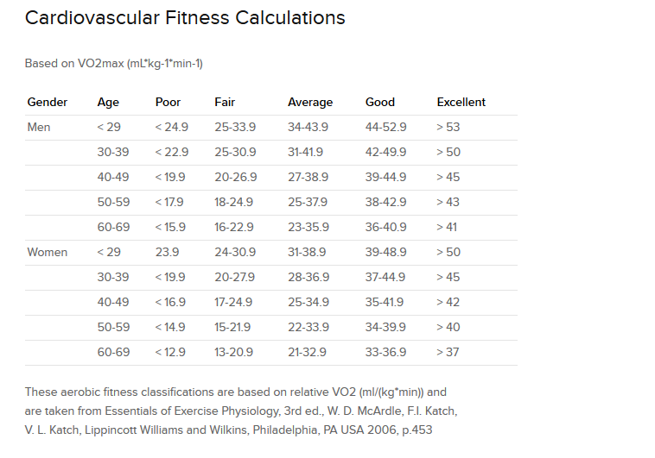

VO2 Max Scores
Steve Prefontaine
VO2 Max Score:
84.4
Courtesy:
Concept2.com

Slide 6
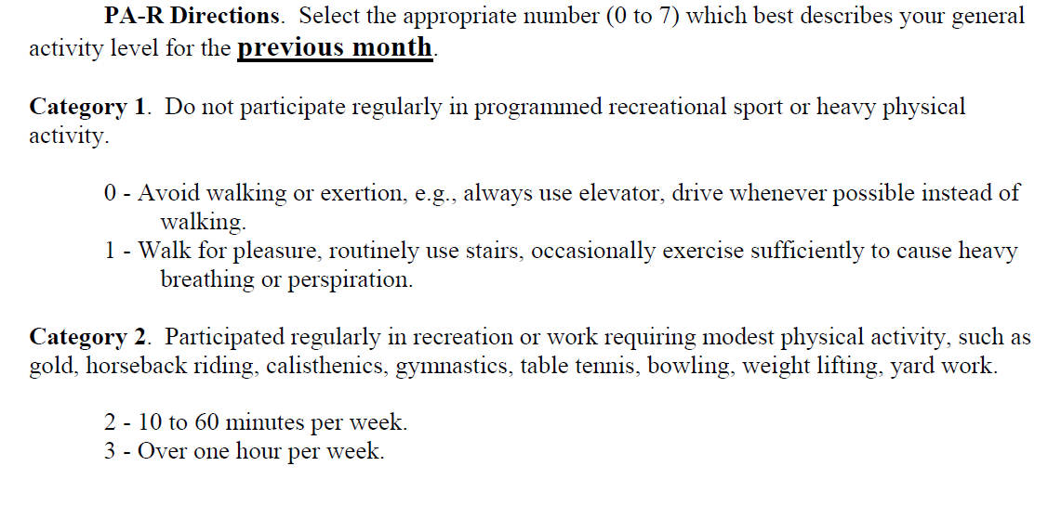
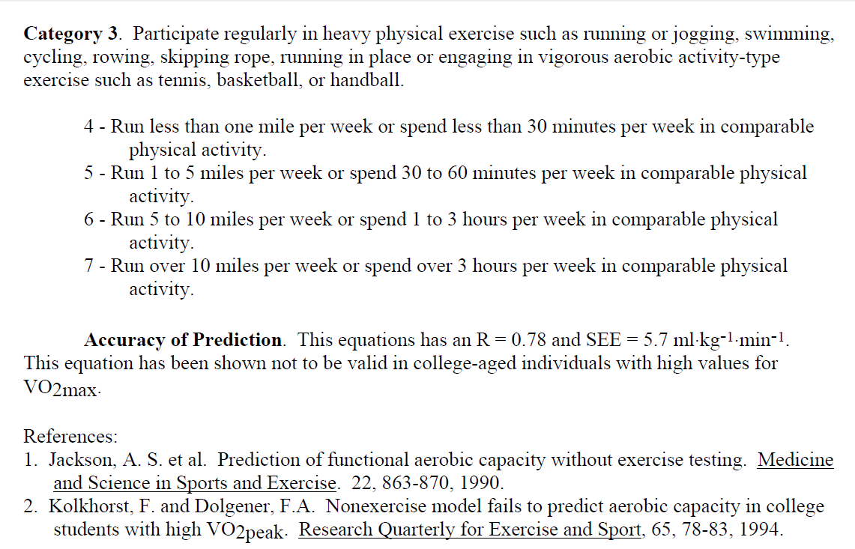
Jackson Non-Physical Test
Courtesy:
University of North Iowa

Slide 7
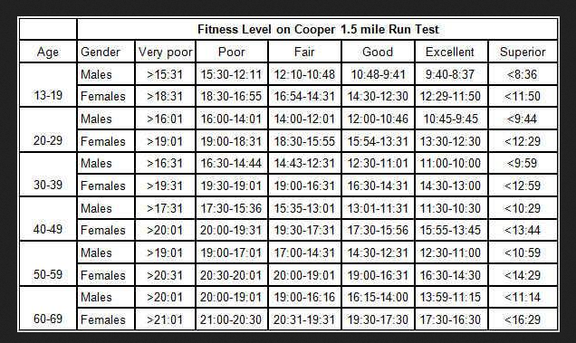
Cooper Fitness Test
Courtesy:
Greater Rochester Track Club

Slide 8
VO2 Max
How do we improve our VO2 Max?
  Develop a regimen of daily cardiovascular activities
  Track our progress
    Our next assignment
  Avoid choices that could damage a healthy lifestyle

